Slide 1

Health Information Management System
Software Engineering Intern Project
Presented by:Abdinoor Mohamed
A web-based solution built with Django Rest Framework, Vue.js, and TailwindCSS for managing clients and health programs efficiently.

Slide 2
Challenge Overview
Understanding the challenge
The goal was to build a complete Health Management system, that allows doctors to create health Programs, register clients,and enroll clients to one or more programs.
Asearch functionality was required toto find registered clients quickly.
Additionaly,sytem should exposeclient profile information securely through Apis so other systems could integrate easily.

Slide 3
Key Delivarables.
Health Program Creation
Client Registration
Client Enrollment
Client Search
API for Client Profiles
Clean Code, Security Focus, Prototype Demonstration
Special Note: I also built a full Django Admin Dashboard for backend management, giving administrators easy control beyond the frontend interface.

Slide 4
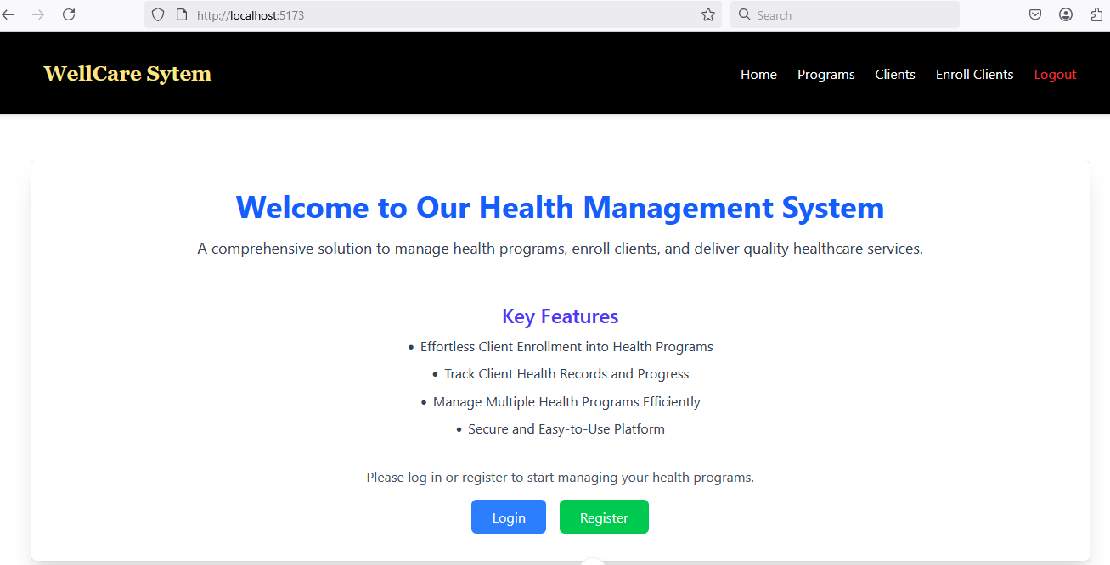
Dashboard

Slide 5
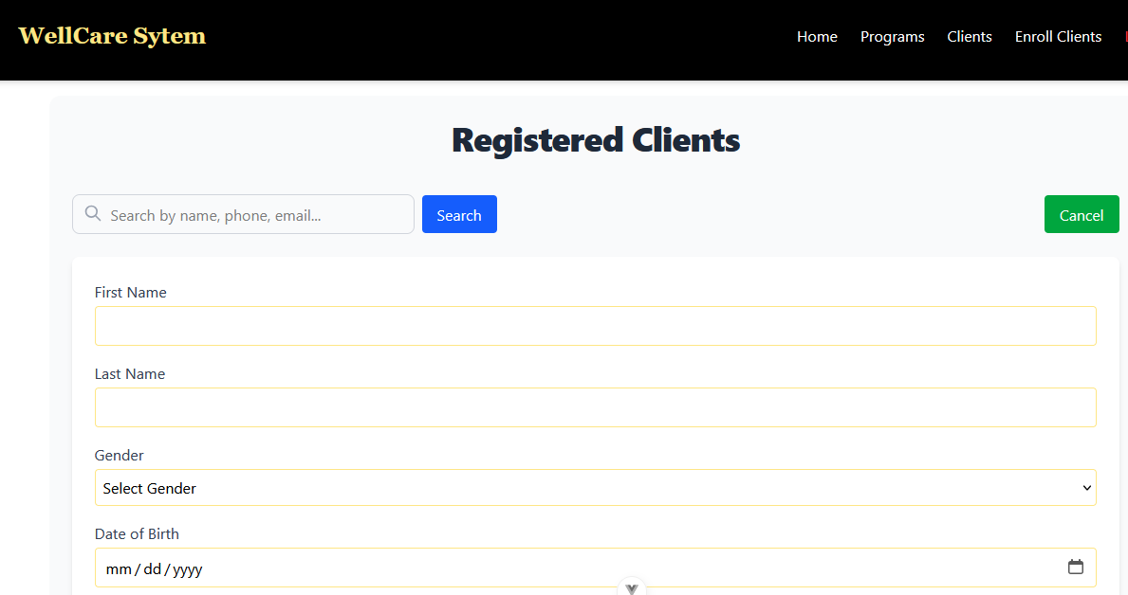
Health Program client Registeration

Slide 6
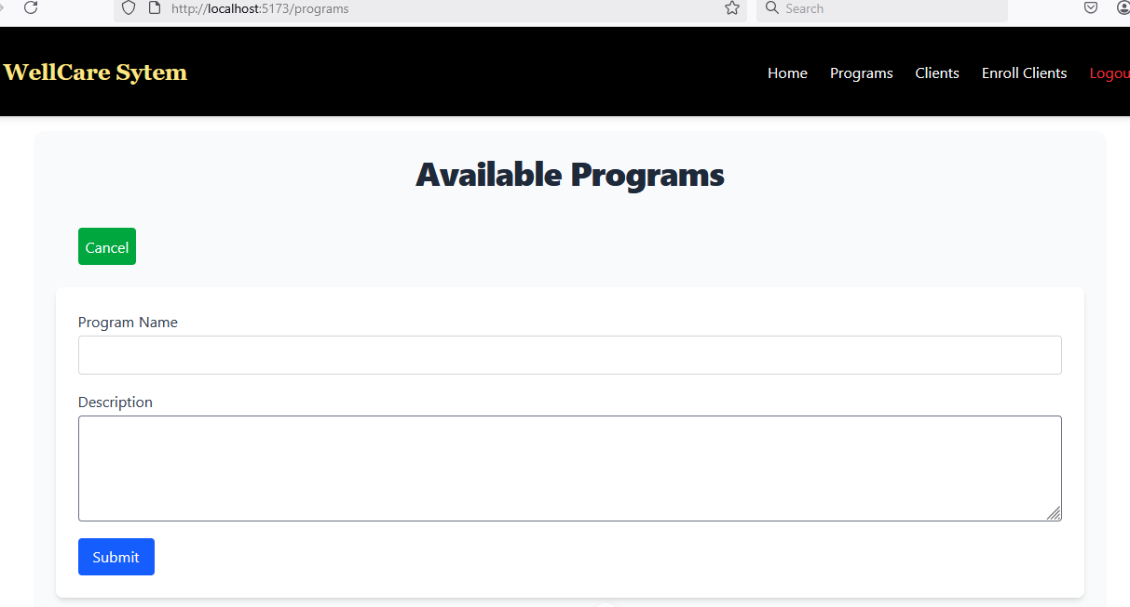
Health Program Creation

Slide 7
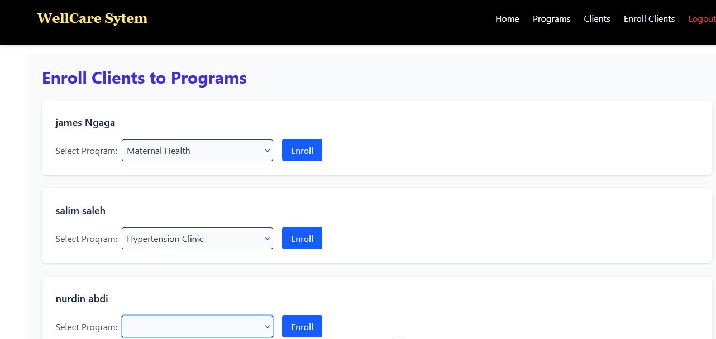
Client Enrollment

Slide 8
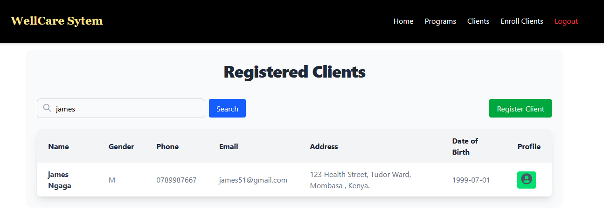
Client Search

Slide 9
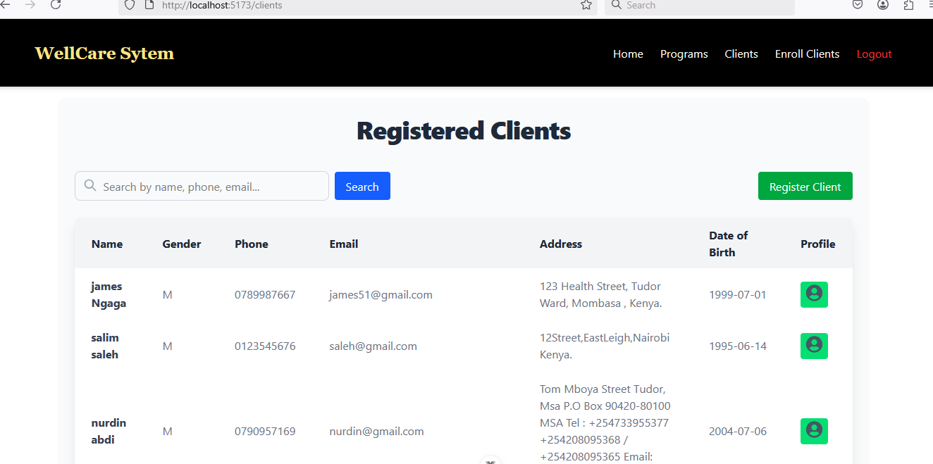
Registered Client Lists

Slide 10
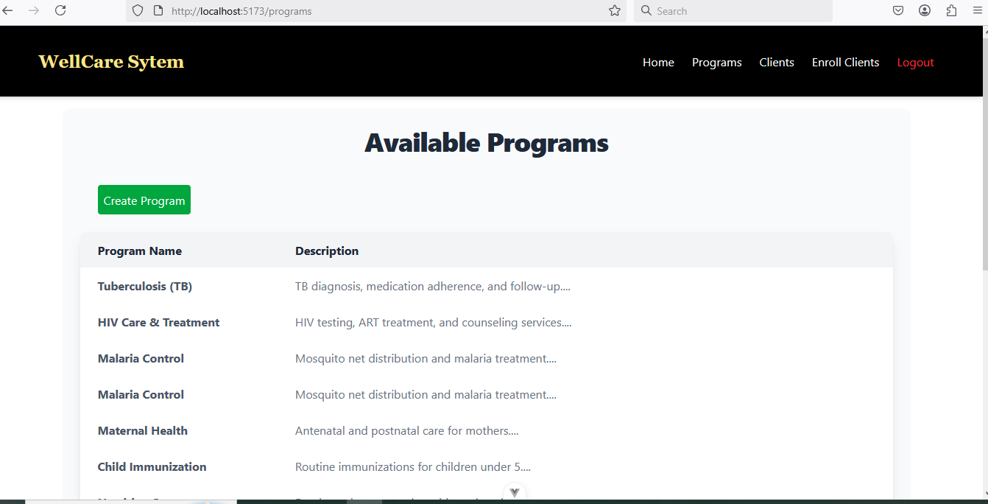
Available Programs

Slide 11
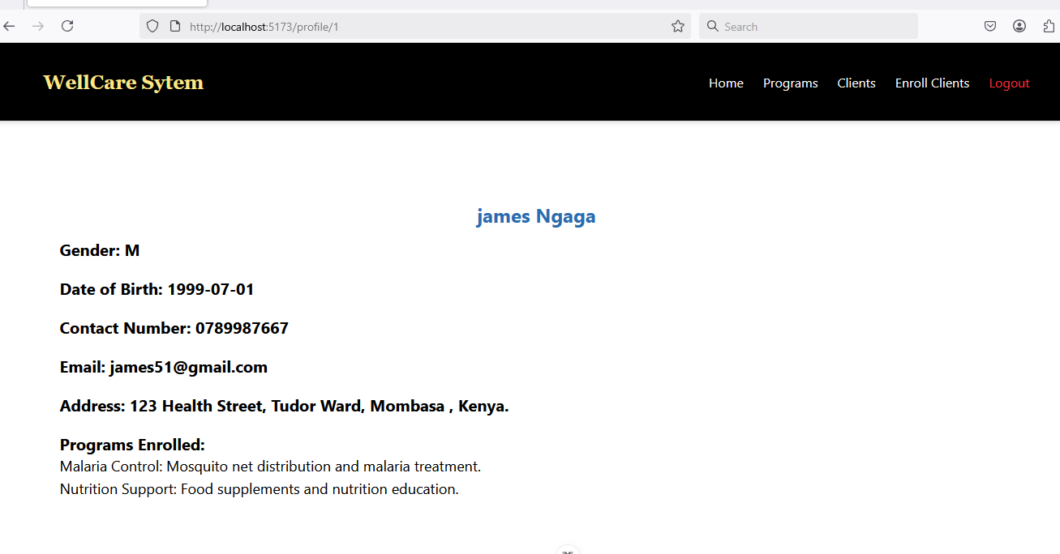
Client Profile

Slide 12
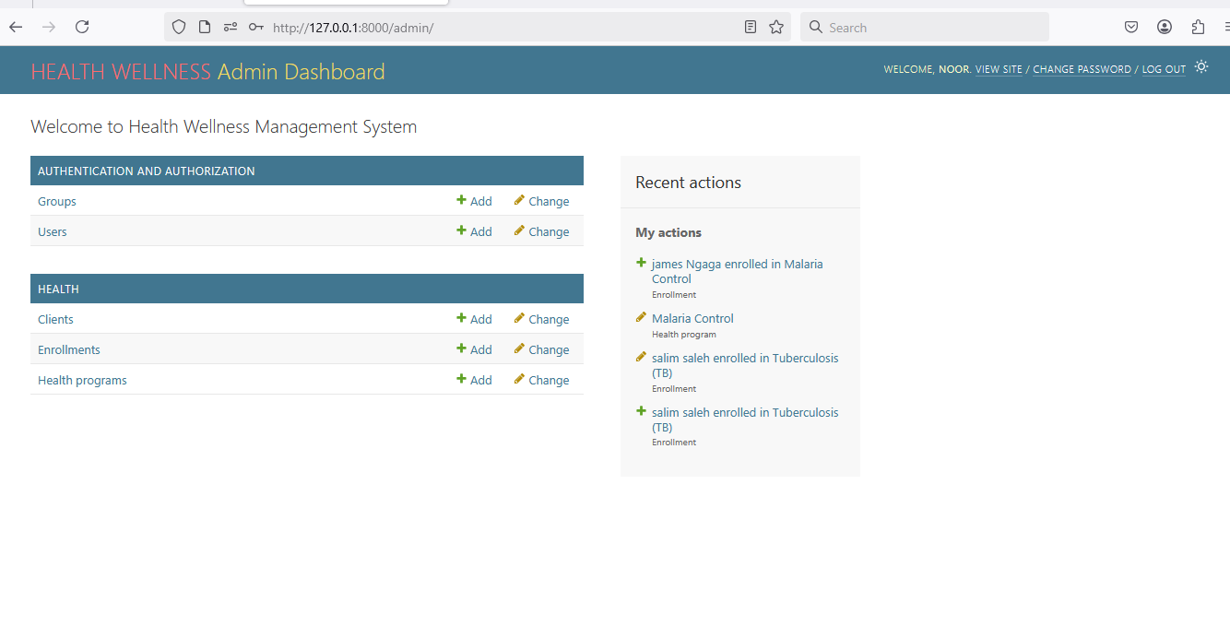
Django Admin Dashboard

Slide 13
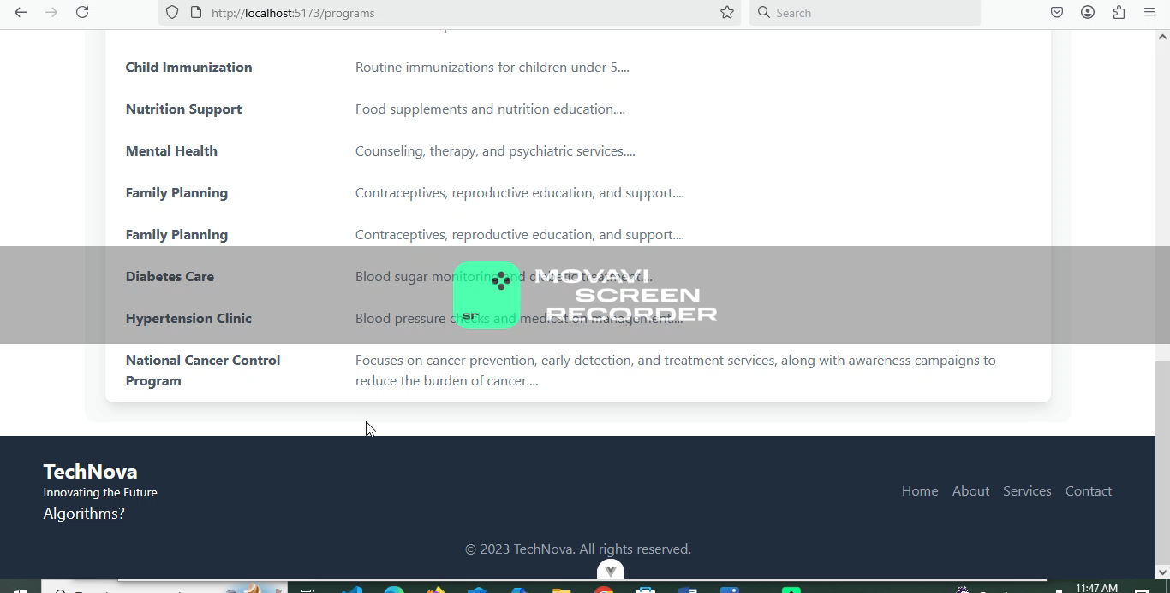
DEMO

